Slide 1
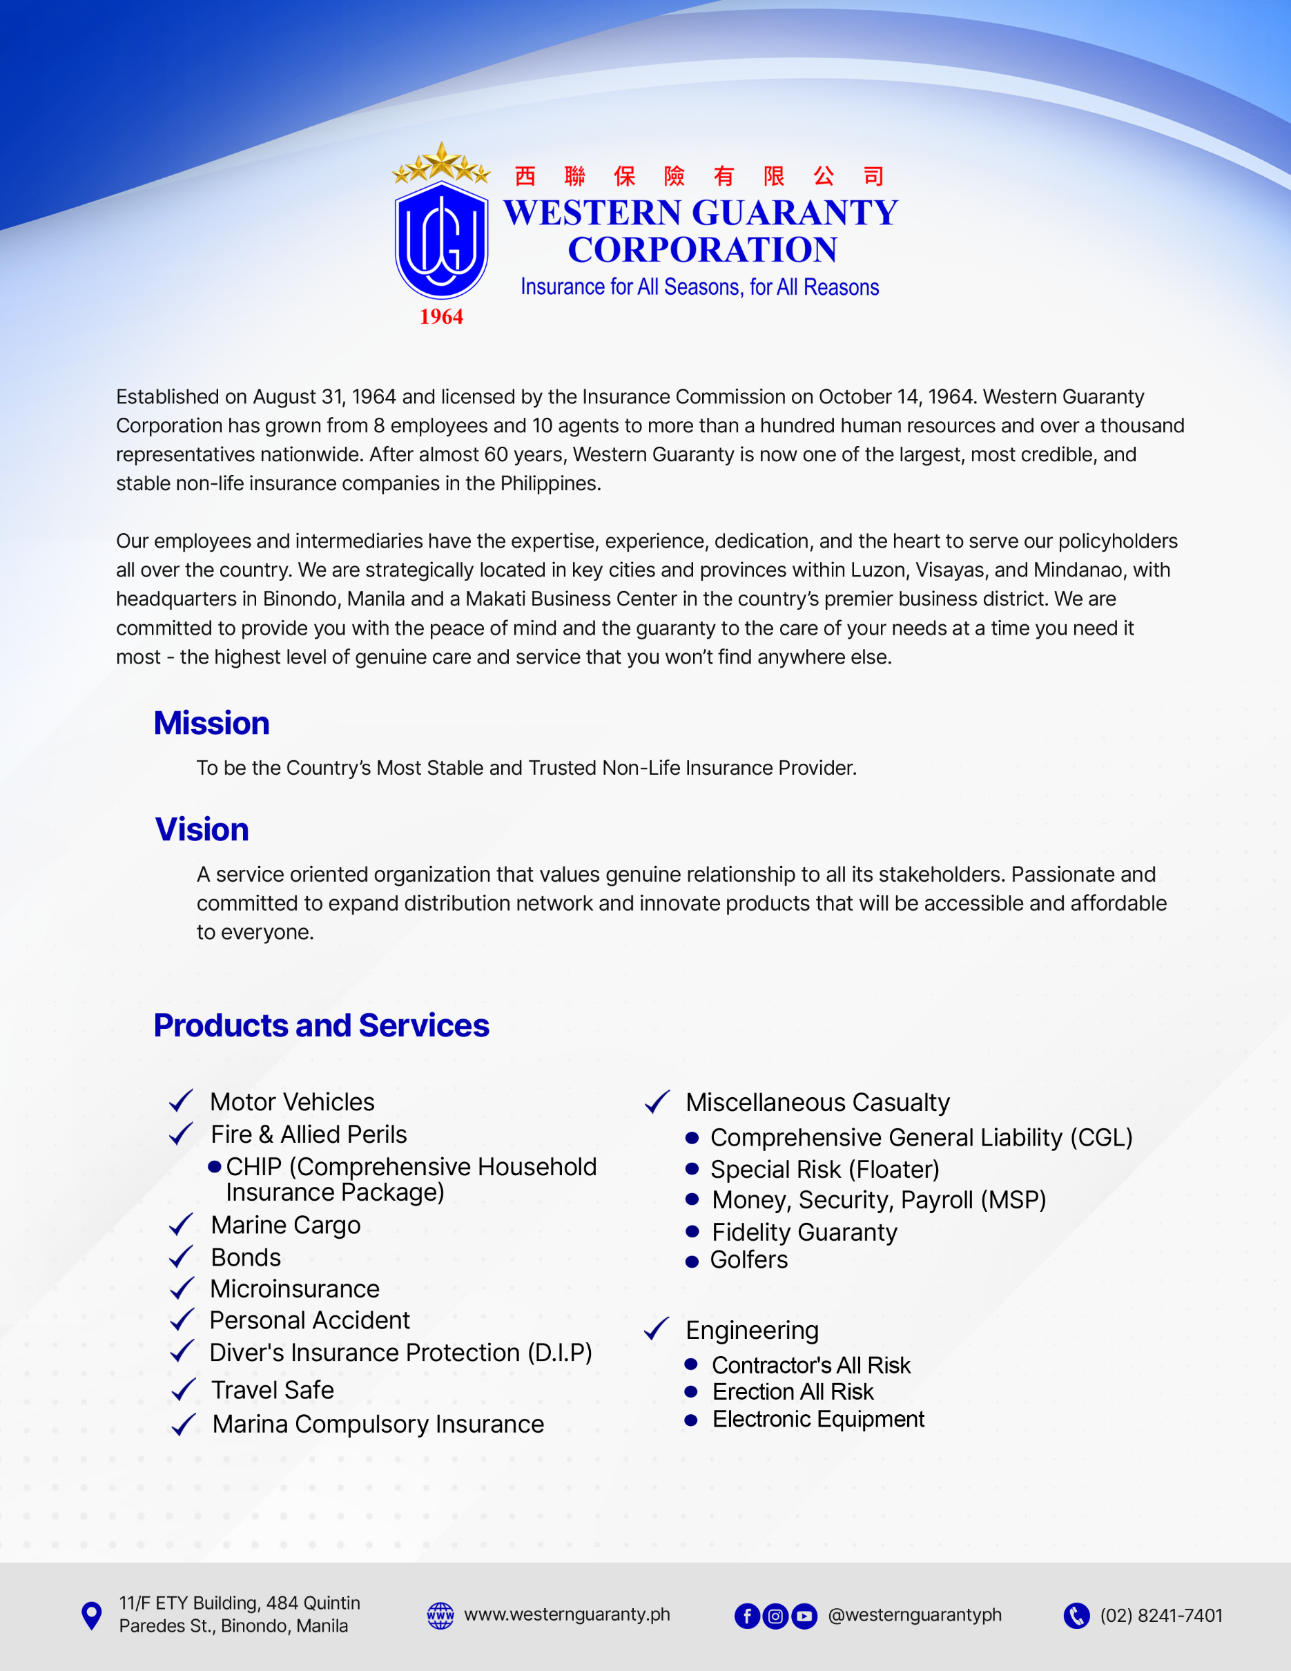
Established on August 31, 1964 and licensed by the Insurance Commission on October 14, 1964. Western Guaranty Corporation has grown from 8 employees and 10 agents to more than a hundred human resources and over a thousand representatives nationwide. After almost 60 years, Western Guaranty is now one of the largest, most credible, and stable non-life insurance companies in the Philippines.
Our employees and intermediaries have the expertise, experience, dedication, and the heart to serve our policyholders all over the country. We are strategically located in key cities and provinces within Luzon, Visayas, and Mindanao, with headquarters in Binondo, Manila and a Makati Business Center in the country's premier business district. We are committed to provide you with the peace of mind and the guaranty to the care of your needs at a time you need it most - the highest level of genuine care and service that you won't find anywhere els
Mission
To be the country’s Most Stable and Trusted Non life Insurance provider
Vision
A service oriented organization that values genuine relationship to all its stakeholders. Passionate and committed to expand distribution network and innovate products that will be accessible and affordable to everyone.
Products and Services
✔ Motor Vehicles
✔ Fire & Allied Perils
CHIP (Comprehensive Household Insurance Package)
✔ Marine Cargo
✔ Bonds
✔ Microinsurance
✔ Personal Accident
✔ Diver's Insurance Protection (D.I.P)
✔ Travel Safe
✔ Marina Compulsory Insurance
✔ Miscellaneous Casualty
Comprehensive General Liability (CGL)
Special Risk (Floater)
Money, Security, Payroll (MSP)
Fidelity Guaranty
Golfers
✔ Engineering
Contractor's All Risk
Erection All Risk
Electronic Equipment
Rev. 08/15/2023

Slide 2
BOARD OF DIRECTORS
Levy Edwin C. Ang
Chairman
Members
Matthew Joseph L. Ang
Geronimo B. Halili
Choa Siu Tin
Maria Joselita L. Ang
David Benjamin L. Ang
Caesar R. Certeza
OFFICERS
Choa Siu Tin
President
Clarita N. Chua
Executive Vice President and
General Manager
Elsa R. Reblora
Corporate Secretary
Vice President – Surety & Administration
Johnson M. Kwan
Vice President - Underwriting
Carmelita M. Pestanio
Vice President - Accounting
Wilfredo S. Magno
Vice President
Fire, Microinsurance, and Reinsurance
Ruben G. Oandasan
Vice President
Branch Operations & Agency Development
Arnold P. Sauz
Assistant Vice President – Reinsurance
Underwriting
Noel P. Bautista
Assistant Vice President – IT Department
Maria Joselita L. Ang
Treasurer
Teresita N. Vergara
Vice President
Comptroller
Bernard Gerard M. Reyes
Vice President
Marketing & Business Development
Lourdes C. Yu
Vice President
Personal Accident & Miscellaneous Casualty
Roberto C. Angeles
Vice President
Makati Business Center
Apolinario P. Manguiat
Vice President – Motor Car Claims
Rowena E. Aninag
Assistant Vice President – Suretyship
Rommel D. Ramirez
Assistant Vice President – Branch & Agency Operations

Slide 3
INTERNAL UNITS
Head Office
Marites C. Eusebio Michael A. Viñas Greg A. Milanes
Manager Manager Manager
General Accounting Motor Car Underwriting Agencies and Gov’t. Support
Conchita D. Docot Maycie S. Sulleza Cristonica G. Antonio
Manager Manager Manager
Collection Marketing & Business Development RI Accounting
Carlo Aldrin Mangundayao Fernando Z. Marcelo Mary Jane J. Tasarra
Manager Manager Manager
Collection/Reconciliation Financial Accounting Receivables
Branch and Satellite Offices
Zalde P. Hernaez Arthur U. Bulan Lester A. Lim
AVP – Davao Branch AVP – Santiago Branch AVP – Cebu Branch &
Region Head for Davao Region Head for North Luzon OIC – Cebu Satellite Office
Region Head for Central & Eastern Visayas
Baltazar A. Milanes, Jr. Erlan Antonius F. Gerangaya Lauro M. Mejia
AVP – Laguna Branch AVP – Bacolod Branch Manager – Dagupan Branch
Region Head for South Luzon Region Head for Western Visayas
OIC – Dumaguete Satellite Office
Michelle D. Camandero Raymundo de Jesus Santiago Federico L. Asis, Jr.
Manager – Iloilo Branch Manager – Cagayan de Oro Branch Manager – Pampanga Branch
Analyn D. Pascual Rogelio T. Laoyon Patrick Joseph Velasco
Manager –Santiago Branch OIC – Samar Satellite Office OIC – Urdaneta Satellite Office
Neilaine R. Binamera Phillip Caesar Corpuz Jose C. Cabilitasan Jr.
Manager – Naga Branch OIC – Cauayan Satellite Office OIC – Tacloban Satellite Office
Manila Business Office
Edgardo P. Idquival Manuel Luis P. Idquival
Managing Director Marketing Director

Slide 4
WGC FINANCIAL HIGHLIGHTS
as of December 2025
Paid-up Capital ₱ 900,000,000.00
Net Worth ₱ 1,982,275,064.00
Gross Premiums Written ₱ 1,826,417,665.00
Net Premium Earned ₱ 1,463,070,961.00
Assets ₱ 3,582,193,898.00
2026 LIST OF REINSURERS
Mapfre Re Compañia de Reaseguros, S.A.
General Insurance Corporation of India
Echo Re
Swiss Re
National Reinsurance Corporation of the Philippines
Allied World Assurance Company (AWAC)
Sava Re
Everest
HANNOVER RE
MS AMLIN
Singapore RE
Korean RE
*Taken from 2025 Audited Financial Statement submitted to SEC and IC.

Slide 5
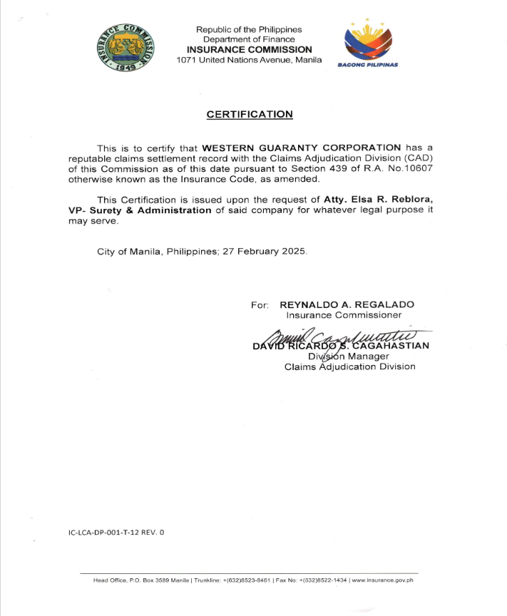

Slide 6
